Slide 1
Bronx Community Health Dashboard: Communicable Disease Last Updated: 9/24/2019 See last slide for more information about this project.

Slide 2
Food- & Water-Borne Diseases
Data note: All data are reported by labs and are not a measure of true incidence in the population as not all people seek care or are tested.

Slide 3
Overall, salmonella rates have declined in all five boroughs
Salmonella is a group of bacteria that is one of the most common causes of food poisoning in the U.S. Most infected people develop diarrhea, fever, and abdominal cramps 12 to 72 hours after infection. The illness typically lasts 4 to 7 days, and most people recover without treatment. However, in some people, the diarrhea may be so severe that they need to be hospitalized.
Data source: New York City Department of Health and Mental Hygiene Communicable Disease Surveillance Data, 2000-2017.
Notes:
UPDATED

Slide 4
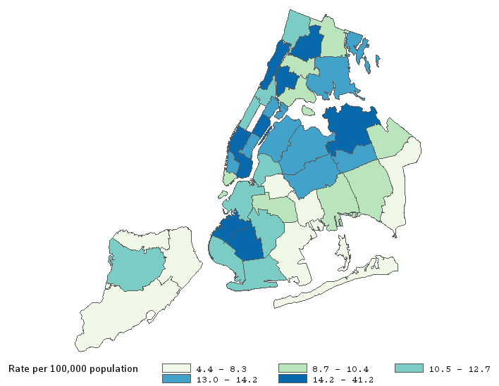
Salmonella rates are above average in the Morrisania, Pelham, and Fordham areas of the Bronx compared to New York City overall
101
101 | Kingsbridge
102 | Northeast Bronx
103 | Fordham
104 | Pelham
105 | Crotona
106 | Morrisania
107 | Mott Haven
103
102
105
104
106
107
Data source: New York City Department of Health and Mental Hygiene Communicable Disease Surveillance Data, 2017.
Notes:
UPDATED

Slide 5
Campylobacter rates have increased in all five boroughs and are highest in Manhattan.
Campylobacter is the leading cause of bacterial diarrheal illness in the U.S. Most cases occur as isolated events, not as part of outbreaks.
Data source: New York City Department of Health and Mental Hygiene Communicable Disease Surveillance Data, 2000-2017.
Notes:
UPDATED

Slide 6
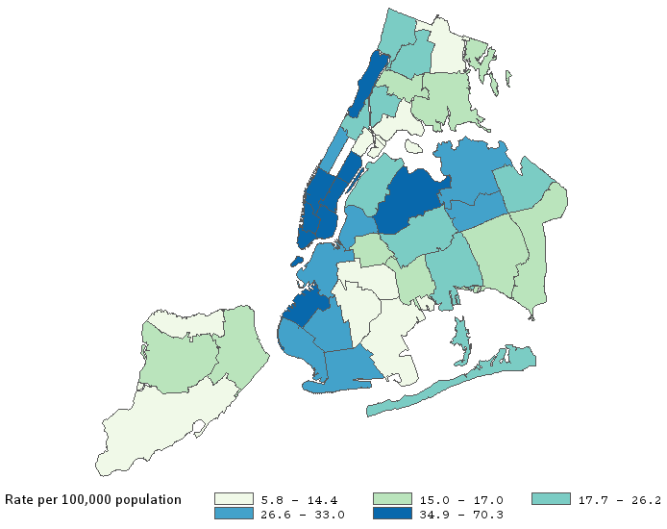
Campylobacter rates are below average in the Bronx and highest in Southwest Brooklyn, Upper Manhattan, Chelsea, and Lower Manhattan
101
101 | Kingsbridge
102 | Northeast Bronx
103 | Fordham
104 | Pelham
105 | Crotona
106 | Morrisania
107 | Mott Haven
103
102
105
104
106
107
Data source: New York City Department of Health and Mental Hygiene Communicable Disease Surveillance Data, 2017.
Notes:
UPDATED

Slide 7
Shigella rates have decreased in all five boroughs, but the most in Brooklyn.
A shigella outbreak outside of NYC spread to Brooklyn in 2008.
Shigella is a group of bacteria that can cause diarrheal disease. Bloody diarrhea, stomach cramps, and fever are common symptoms.
Data source: New York City Department of Health and Mental Hygiene Communicable Disease Surveillance Data, 2000-2017.
Notes:
UPDATED

Slide 8
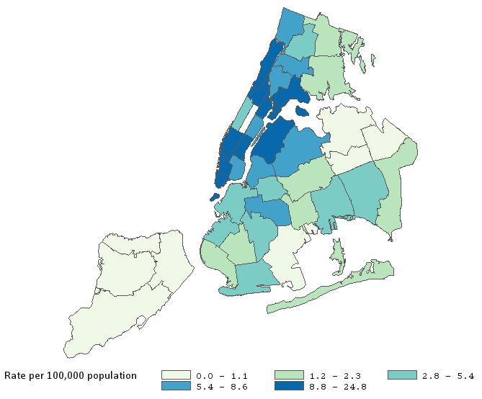
Shigella rates are higher in Mott Haven, Morrisania and Kingsbridge areas of the Bronx as compared to NYC overall
101
101 | Kingsbridge
102 | Northeast Bronx
103 | Fordham
104 | Pelham
105 | Crotona
106 | Morrisania
107 | Mott Haven
103
102
105
104
106
107
Data source: New York City Department of Health and Mental Hygiene Communicable Disease Surveillance Data, 2017.
Notes:
UPDATED

Slide 9
Giardia rates have decreased in all five boroughs, but the most in Manhattan
Giardia is a single-celled parasite that can cause diarrheal disease. Abdominal cramps, bloating, nausea, and bouts of watery diarrhea are common symptoms.
Data source: New York City Department of Health and Mental Hygiene Communicable Disease Surveillance Data, 2000-2017.
Notes:
UPDATED

Slide 10
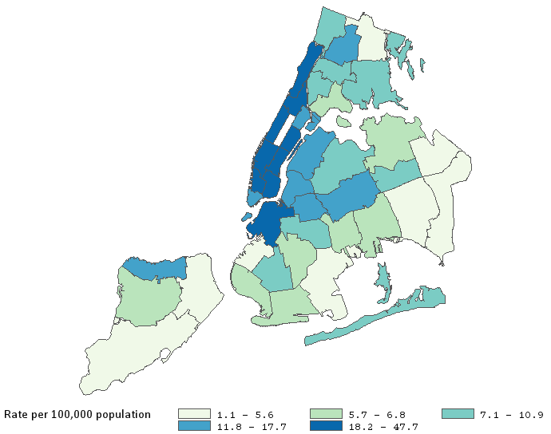
Except for Fordham, Giardia rates are below average in the Bronx and highest in all of Manhattan and downtown Brooklyn
101
101 | Kingsbridge
102 | Northeast Bronx
103 | Fordham
104 | Pelham
105 | Crotona
106 | Morrisania
107 | Mott Haven
103
102
105
104
106
107
Data source: New York City Department of Health and Mental Hygiene Communicable Disease Surveillance Data, 2017.
Notes:
UPDATED

Slide 11
Cryptosporidiosis (crypto) rates have nearly doubled in the Bronx
Crypto is a diarrheal disease caused by microscopic parasites that can reside in the intestines of humans and animals and get transmitted through the fecal-oral route, often through contaminated water. Over 98% of cases go unreported in the U.S.
Data source: New York City Department of Health and Mental Hygiene Communicable Disease Surveillance Data, 2000-2017. Data missing for Staten Island for 2008, 2009, and 2012.

Slide 12
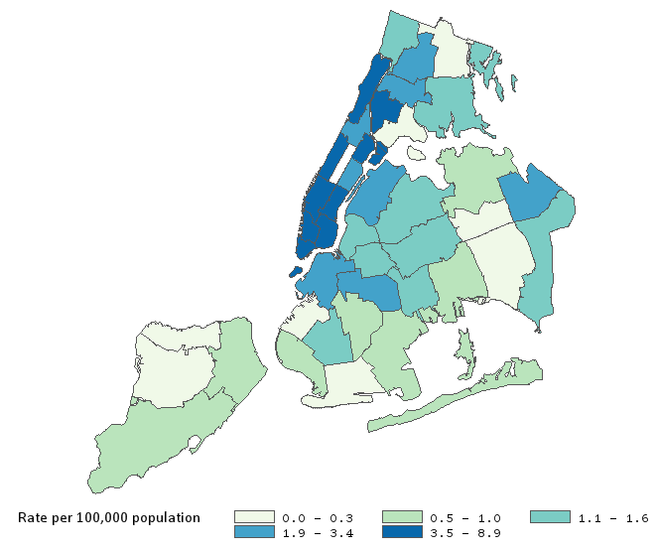
Crypto rates are above average in Morrisania and Crotona areas of the Bronx as compared to NYC overall
101 | Kingsbridge
102 | Northeast Bronx
103 | Fordham
104 | Pelham
105 | Crotona
106 | Morrisania
107 | Mott Haven
101
103
102
105
104
106
107
Data source: New York City Department of Health and Mental Hygiene Communicable Disease Surveillance Data, 2017.
Notes:
UPDATED

Slide 13
Amebiasis rates have decreased in all boroughs except Staten Island, but the most in Manhattan.
Amebiasis is an intestinal infection that is caused by the parasite Entamoeba histolytica. In some cases, it invades the colon wall, causing colitis, acute dysentery, or chronic diarrhea.
Data source: New York City Department of Health and Mental Hygiene Communicable Disease Surveillance Data, 2000-2017.
Notes:
UPDATED

Slide 14
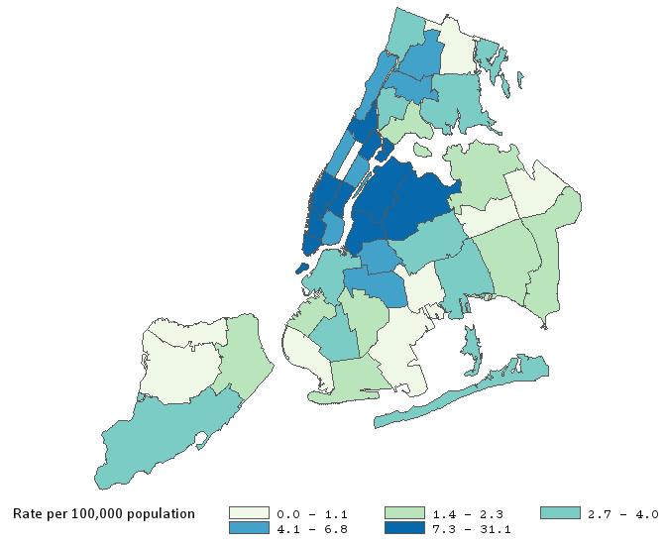
Amebiasis rates are above average in the Crotona area of the Bronx as compared to NYC overall
101 | Kingsbridge
102 | Northeast Bronx
103 | Fordham
104 | Pelham
105 | Crotona
106 | Morrisania
107 | Mott Haven
101
103
102
105
104
106
107
Data source: New York City Department of Health and Mental Hygiene Communicable Disease Surveillance Data, 2017.
Notes:
UPDATED

Slide 15
Vector-Borne Diseases
Data note: All data are reported by labs and are not a measure of true incidence in the population as not all people seek care or are tested.

Slide 16
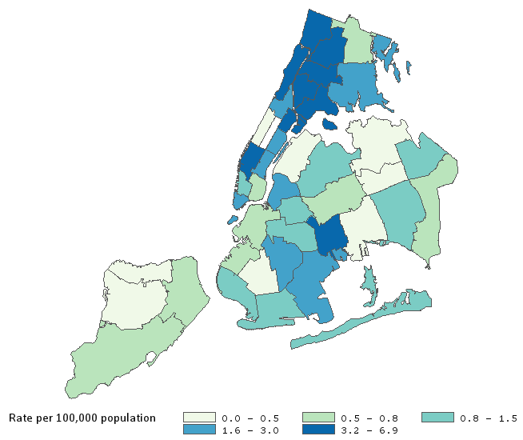
The Bronx had the highest burden of Zika in 2017
Zika is a virus that is mainly spread by mosquitoes. A pregnant mother can transmit it to her baby during pregnancy or around the time of birth. It can spread through sexual contact.
101
103
102
105
104
Orange indicates Bronx community districts
106
107
NYC Overall
Data source: New York City Department of Health and Mental Hygiene Communicable Disease Surveillance Data, 2017
Based on CDC/CSTE case definition of non-congenital Zika disease and infection. Data not available prior to 2016.
Notes:
UPDATED

Slide 17
In NYC overall, Zika rates are highest for 25-44 year olds and women
Data source: New York City Department of Health and Mental Hygiene Communicable Disease Surveillance Data, 2017.
Rates for age not age-adjusted.
Notes:
UPDATED

Slide 18
In NYC overall, Zika rates are highest in high poverty neighborhoods
Data source: New York City Department of Health and Mental Hygiene Communicable Disease Surveillance Data, 2017.
Notes:
UPDATED

Slide 19
Malaria rates have decreased in all boroughs except the Bronx, where the malaria rate is highest and has modestly increased
Malaria is a life-threatening disease caused by a parasite, transmitted through the bite of infected mosquitoes. It was eliminated from the U.S. in the early 1950s, but between 1,500 and 2,000 cases still occur annually, mostly in people who have recently traveled to malaria-endemic areas.
As NYC has a large number of international migrants, most of these are imported cases.
Data source: New York City Department of Health and Mental Hygiene Communicable Disease Surveillance Data, 2000-2017.
Notes:
UPDATED

Slide 20
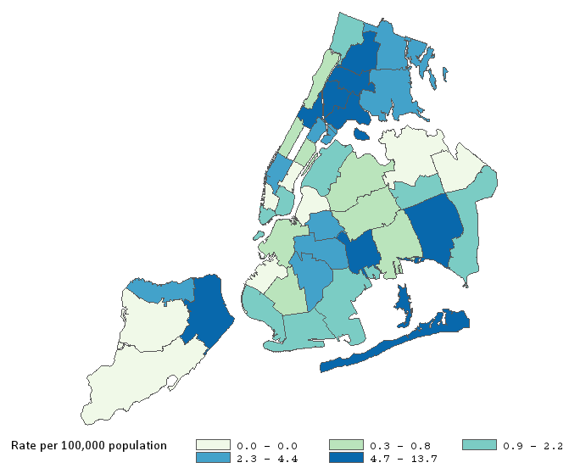
Malaria rates are highest in the Bronx, Central Harlem, and North Staten Island
101
101 | Kingsbridge
102 | Northeast Bronx
103 | Fordham
104 | Pelham
105 | Crotona
106 | Morrisania
107 | Mott Haven
103
102
105
104
106
107
Data source: New York City Department of Health and Mental Hygiene Communicable Disease Surveillance Data, 2017.
Notes:
UPDATED

Slide 21
In NYC overall, malaria rates are highest for 45-64 year olds and men
Data source: New York City Department of Health and Mental Hygiene Communicable Disease Surveillance Data, 2017.
Rates for age not age-adjusted.
Notes:
UPDATED

Slide 22
In NYC overall, malaria rates increase as neighborhood poverty level increases
Data source: New York City Department of Health and Mental Hygiene Communicable Disease Surveillance Data, 2017.
Notes:
UPDATED

Slide 23
Lyme disease rates have increased in all five boroughs, but most dramatically in Staten Island. Rates are lowest in the Bronx.
Lyme disease is caused by a bacterium that is transmitted to humans through the bite of infected backlegged ticks. Fever, headache, fatigue, and a skin rash called erythema migrans are common symptoms.
Data source: New York City Department of Health and Mental Hygiene Communicable Disease Surveillance Data, 2000-2017.
Notes:
UPDATED

Slide 24
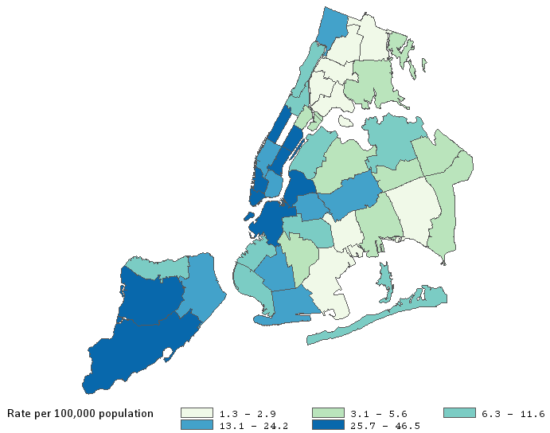
Lyme disease rates are below average in the Bronx except for Kingsbridge and are highest in Northwest Brooklyn, Manhattan and Staten Island
101
101 | Kingsbridge
102 | Northeast Bronx
103 | Fordham
104 | Pelham
105 | Crotona
106 | Morrisania
107 | Mott Haven
103
102
105
106
104
107
Data source: New York City Department of Health and Mental Hygiene Communicable Disease Surveillance Data, 2017.

Slide 25
Other Communicable Diseases
Data note: All data are reported by labs and are not a measure of true incidence in the population as not all people seek care or are tested.

Slide 26
For all boroughs, rates of new TB infections have declined. In the Bronx, the rate has decreased by 55%
TB is a disease caused by bacteria that are transmitted from person to person through tiny droplets released into the air via coughs and sneezes. The bacteria typically attack the lungs, but they can also affect other parts of the body. Many TB strains resist the drugs most used to treat the disease. People with active TB must take several types of medications for many months to eradicate the infection.
Data source: New York City Department of Health and Mental Hygiene Tuberculosis Surveillance Data, 2001-2017.

Slide 27
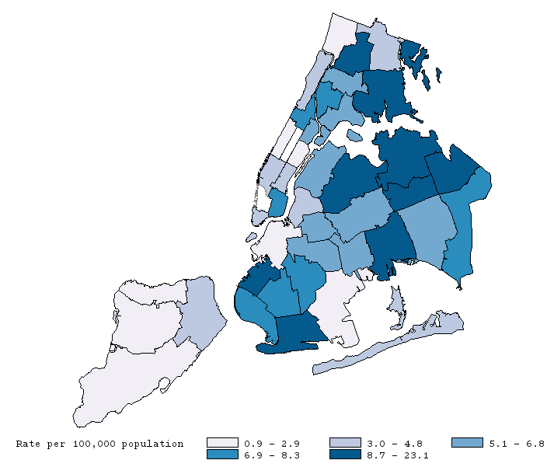
TB rates are about average in the Bronx and highest in Queens
Orange indicates Bronx community districts
101
103
102
NYC Overall
105
104
106
107
Data source: New York City Department of Health and Mental Hygiene Tuberculosis Surveillance Data, 2017.
Notes:
UPDATED

Slide 28
In the Bronx, TB rates are highest for those who are 20-29 year old, male, and Asian/Pacific Islander
Data source: New York City Department of Health and Mental Hygiene Tuberculosis Surveillance Data, 2017.
Notes:
UPDATED

Slide 29
The chronic hepatitis B rate has remained stable in the Bronx, but declined in Brooklyn, Manhattan and Queens
Hepatitis B is a liver infection caused by the hepatitis B virus. It is transmitted when people come in contact with the blood, open sores, or body fluids of someone who has the virus. Having chronic hepatitis B increases the risk of developing liver failure, liver cancer or cirrhosis.
Data source: New York City Department of Health and Mental Hygiene Communicable Disease Surveillance Data, 2006-2017.
Notes:
UPDATED

Slide 30
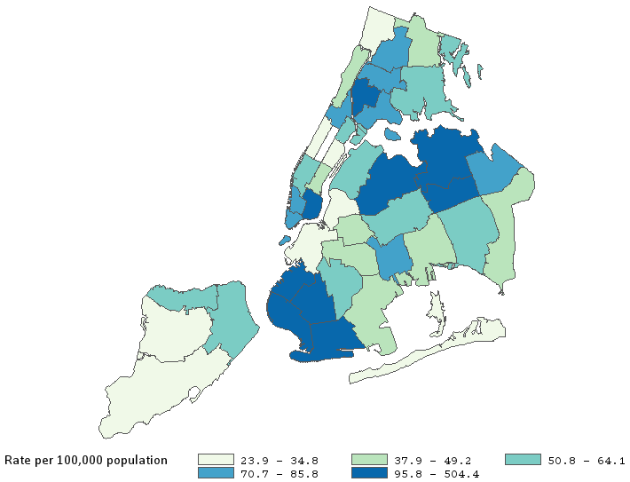
Chronic hepatitis B rates are about average in the Bronx, and highest in Queens, Southwest Brooklyn, and Lower Manhattan
101
101 | Kingsbridge
102 | Northeast Bronx
103 | Fordham
104 | Pelham
105 | Crotona
106 | Morrisania
107 | Mott Haven
102
103
106
105
104
107
Data source: New York City Department of Health and Mental Hygiene Communicable Disease Surveillance Data, 2017.
Notes:
UPDATED

Slide 31
In NYC overall, chronic hepatitis B rates are highest for 30-39 year olds and men
Data source: New York City Department of Health and Mental Hygiene Communicable Disease Surveillance Data, 2017.
Rates for age not age-adjusted.
Notes:
UPDATED

Slide 32
In NYC overall, chronic hepatitis B rates increase as neighborhood poverty level increases
Data source: New York City Department of Health and Mental Hygiene Communicable Disease Surveillance Data, 2017.
Notes:
UPDATED

Slide 33
The chronic hepatitis C rate has decreased by 71% in the Bronx
In the U.S., infection with hepatitis C virus is the most common cause of chronic hepatitis. Chronic hepatitis C is usually curable with oral medications taken daily for two to six months. However, about half of people with the disease do not know that they are infected because most symptoms do not appear until cirrhosis develops and the liver begins to fail.
Data source: New York City Department of Health and Mental Hygiene Communicable Disease Surveillance Data, 2006-2017.
Notes:
UPDATED

Slide 34
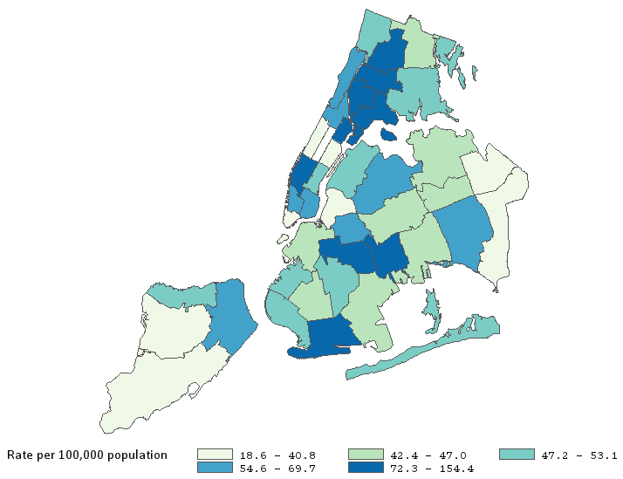
Four of the 10 neighborhoods with the highest chronic hepatitis C rates are in the Bronx
101
102
101 | Kingsbridge
102 | Northeast Bronx
103 | Fordham
104 | Pelham
105 | Crotona
106 | Morrisania
107 | Mott Haven
103
106
105
104
107
Data source: New York City Department of Health and Mental Hygiene Communicable Disease Surveillance Data, 2017.
Notes:
UPDATED

Slide 35
In NYC overall, chronic hepatitis C rates are highest for 60-69 year olds and men
Data source: New York City Department of Health and Mental Hygiene Communicable Disease Surveillance Data, 2017.
Rates for age not age-adjusted.
Notes:
UPDATED

Slide 36
In NYC overall, chronic hepatitis C rates increase as neighborhood poverty level increases
Data source: New York City Department of Health and Mental Hygiene Communicable Disease Surveillance Data, 2017.
Notes:
UPDATED

Slide 37
The legionella rate in the Bronx has increased 7-fold from 2000 to 2017
There were two Legionella outbreaks in the Bronx in 2015.
Legionella is a respiratory disease caused by bacteria that grow and multiply in a building water system. When contaminated water spreads in droplets small enough for people to breathe in, people can acquire a serious type of pneumonia called Legionnaires’ disease.
Data source: New York City Department of Health and Mental Hygiene Communicable Disease Surveillance Data, 2000-2017.
Data missing for Staten Island for 2001.

Slide 38
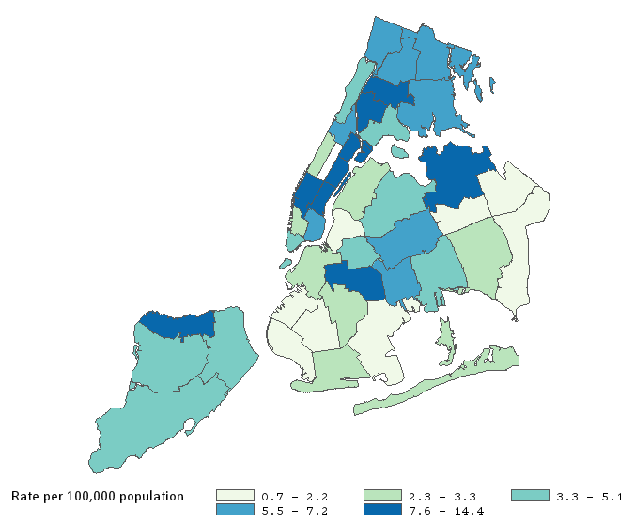
Two of the 10 neighborhoods with the highest Legionella rates are in the Bronx
101 | Kingsbridge
102 | Northeast Bronx
103 | Fordham
104 | Pelham
105 | Crotona
106 | Morrisania
107 | Mott Haven
101
103
102
105
104
106
107
Data source: New York City Department of Health and Mental Hygiene Communicable Disease Surveillance Data, 2017.
Notes:
UPDATED

Slide 39
In NYC overall, Legionella rates are highest for 65+ year olds and men
Data source: New York City Department of Health and Mental Hygiene Communicable Disease Surveillance Data, 2017.
Rates for age not age-adjusted.
Notes:
UPDATED

Slide 40
In NYC overall, Legionella rates are higher in neighborhoods with higher poverty
Data source: New York City Department of Health and Mental Hygiene Communicable Disease Surveillance Data, 2017.
Notes:
UPDATED

Slide 41
The streptococcus pneumoniae rate has increased over 3-fold
in the Bronx
Streptococcus pneumoniae are bacteria that can cause many types of illnesses, including pneumonia, ear infections, sinus infections, meningitis, and bacteremia.
Data source: New York City Department of Health and Mental Hygiene Communicable Disease Surveillance Data, 2001-2017.

Slide 42
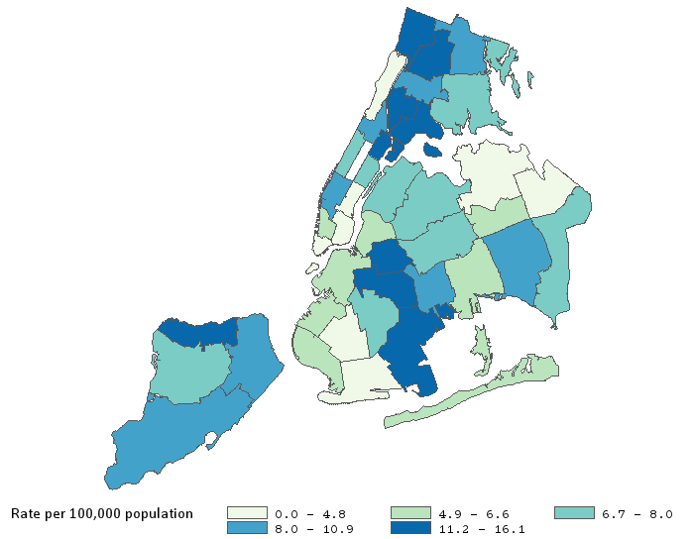
Four of the 10 neighborhoods with the highest streptococcus pneumoniae rates are in the Bronx
101 | Kingsbridge
102 | Northeast Bronx
103 | Fordham
104 | Pelham
105 | Crotona
106 | Morrisania
107 | Mott Haven
101
102
103
105
104
106
107
Data source: New York City Department of Health and Mental Hygiene Communicable Disease Surveillance Data, 2017
Notes:
UPDATED

Slide 43
In NYC overall, streptococcus pneumoniae rates are highest for 65+ year olds and men
Data source: New York City Department of Health and Mental Hygiene Communicable Disease Surveillance Data, 2017.
Rates for age not age-adjusted.
Notes:
UPDATED

Slide 44
In NYC overall, streptococcus pneumoniae rates are higher in neighborhoods with higher poverty
Data source: New York City Department of Health and Mental Hygiene Communicable Disease Surveillance Data, 2017.
Notes:
UPDATED

Slide 45
About the Community Health Dashboard Project
The goal of the project is to provide Bronx-specific data on risk factors and health outcomes with an emphasis on presenting data on trends, socio-demographic differences (e.g., by age, sex, race/ethnicity, etc.) and sub-county/neighborhood level data
Data will be periodically updated as new data becomes available.
Produced by Montefiore’s Office of Community & Population Health using publicly-available data sources
For more information, please contact us at OCPHDept@montefiore.org

